Slide 1
SQL
Presenter: Xiumin Wang
Email: xmwang@scut.edu.cn
Office: B3-312

Slide 2
Outline
Introduction
Data Definition Language (DDL)
  Fundamental concepts
Data Manipulation Language (DML)
Data Definition Language (DDL)
  Advanced concepts

Slide 3
Introduction
Structured Query Language (SQL)
  the most widely used relational database language.
It was originally developed at IBM in the SEQUEL-XRM and System-R projects (1974-1977).
  SEQUEL (Structured English Query Language)
Many products now support the SQL language. SQL clearly established itself as the standard relational database language.

Slide 4
Introduction
The SQL continues to evolve in response to the changing need.
The ANSI/ISO standards for SQL include
  SQL-86, SQL-89, SQL-92, SQL:1999, SQL:2003, SQL:2006, SQL:2008, SQL:2011, SQL:2016.
SQL can do much more than just query a database. It can define the structure of the data, modify the data in database, and specify the security constraints.

Slide 5
Outline
Introduction
Data Definition Language (DDL)
  Fundamental concepts
Data Manipulation Language (DML)
Data Definition Language (DDL)
  Advanced concepts

Slide 6
Data Definition Language (DDL)
DDL allows a specification of not only a set of relations, but also information about each relation, including
  The schema for each relation
  The domain of values associated with each attribute
  Integrity constraints (ICs)
  The physical storage structure of each relation on disk
  The set of indices to be maintained for each relation
  Security and authorization information for each relation

Slide 7
Domain Types in SQL
char(n) Fixed-length character string, with user-specified length n.
varchar(n) Variable-length character string, with user-specified maximum length n.
int integer (a finite subset of the integers that is machine-dependent).
smallint Small integer (a machine-dependent subset of the integer domain type).
Numeric(p,d) Fixed point number, with user-specified precision. The number consists of p digits, and d of the p digits are to the right of the decimal point.

Slide 8
Domain Types in SQL
real, double precision Floating point and double-precision floating point numbers, with machine-dependent precision.
float(n) Floating point number, user-specified precision by parameter n.
date Dates, containing a (4 digits) year, month and date.
time Time of day, in hours, minutes and seconds.

Slide 9
Domain Types in SQL
  Each type may include a special value called the null value.
  A null value indicates a value that may exist but is not known, or that may not exist at all.
  Declaring an attribute to be not null means the null value for that attribute is not allowed.

Slide 10
Schema Definition in SQL
create table customer
( customer-name char(20) not null,
customer-street char(30),
customer-city char(30),
primary key (customer-name));
customer
customer-name
customer-street
customer-city

Slide 11
Schema Definition in SQL
The general form of the create table command:
create table r
(A₁ D₁,
A₂ D₂,
…
A_{n} D_{n},
<integrity-constraint₁>,
…
<integrity-constraint_{k}>);

Slide 12
Integrity Constraints (ICs)
IC: condition that must be true for any instance of the database.
  E.g. The not null constraint means the value of the attribute cannot be null.
ICs are specified when the schema is defined.
ICs are checked when relations are modified.

Slide 13
Schema Definition in SQL
SQL supports a number of different integrity constraints:
  primary key (A_{j1}, A_{j2}, …, A_{jm}): ensures non-null automatically, e.g.,
  primary key (customer-name)
  foreign key (A_{k1}, A_{k2}, …, A_{kn}) reference s: e.g.,
  foreign key (dept-name) references department
  not null: e.g.,
  customer-name char(20) not null

Slide 14
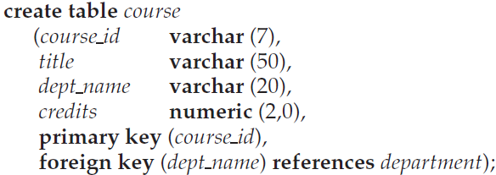
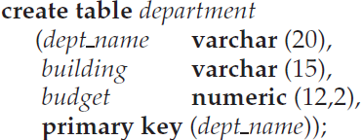
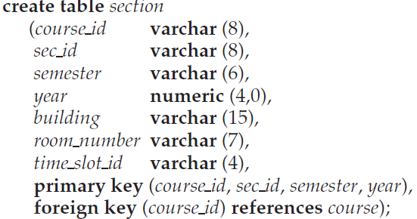
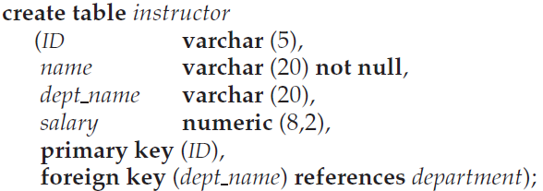
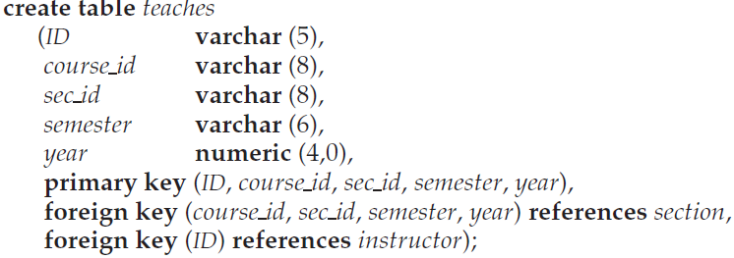

Slide 15
Drop Table
To remove a relation from a SQL database, we use the drop table command:
  drop table r: delete all information about the dropped relation from DB.

Slide 16
Alter Table
We use the alter table command to add or delete attributes to/from an existing relation.
  alter table customer add phone char(10)
  alter table customer drop phone
All tuples in the relation are assigned null for a new attribute.

Slide 17
More details will be discussed later.

Slide 18
Outline
Introduction
Data Definition Language (DDL)
  Fundamental concepts
Data Manipulation Language (DML)
Data Definition Language (DDL)
  Advanced concepts

Slide 19
Data Manipulation Language (DML)
Basic SQL Query
Arithmetic Operation
Rename Operation
String Operation
Ordering the Display of Tuples
Aggregate Operator
Set Operation
Natural Join
Nested subqueries
Division
Group By
NULL value
Sequence

Slide 20
Basic SQL Query
Query on relations
  The query takes the relations listed in the from clause as the input, operates on them as specified in the where and select clauses, and then produces a relation as the result.
SELECT [DISTINCT] target-list
FROM relation-list
WHERE qualification

Slide 21
Basic SQL Query
Query on relations
  relation-list
    A list of relation names.
  target-list
    A list of attributes of relations in relation-list.
SELECT [DISTINCT] target-list
FROM relation-list
WHERE qualification

Slide 22
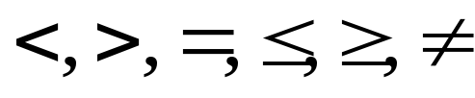
Basic SQL Query
Query on relations
  distinct
    an optional keyword indicating that the answer should not contain duplicates. Default is that duplicates are not eliminated.
  qualification
    Comparisons (Attr op const or Attr1 op Attr2, where op is one of ) combined using AND, OR and NOT.
SELECT [DISTINCT] target-list
FROM relation-list
WHERE qualification

Slide 23
SELECT [DISTINCT] target-list
FROM relation-list
WHERE qualification
SELECT clause
  specifies columns to be retained in the result.
FROM clause
  specifies a cross-product of tables.
WHERE clause (optional)
  specifies selection conditions on the tables mentioned in the FROM clause.
A SQL query intuitively corresponds to a relational algebra expression involving selections, projections, and cross-products.

Slide 24
SELECT DISTINCT a₁, a₂, …, a_{n}
FROM R₁, R₂, …, R_{m}
WHERE P
Π _{a1, a2, …, an} ( σ _{P} ( R₁ x R₂ x … x R_{m} ) )

Slide 25
Note: for our examples we use the tables:
  Branch (branch-name, branch-city, assets)
  Customer (customer-name, customer-street, customer-city)
  Loan (loan-number, amount, branch-name)
  Account (account-number, balance, branch-name)
  Borrower (customer-name, loan-number)
  Depositor (customer-name, account-number)
Assume that customer-name is UNIQUE in this example.
(In real life applications, (customer) name is NOT unique.)

Slide 26

Example
Find the names of all branches in the loan relation.
  Loan (loan-number, amount, branch-name)
Loan
SELECT branch-name
FROM Loan
Result

Slide 27
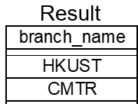
Example
  Loan (loan-number, amount, branch-name)
Find the (distinct) branch-name of all the loans
How about the following two queries?
select branch-name
from Loan;
select distinct branch-name
from Loan;
Result
select loan-number from Loan;
select distinct loan-number
from Loan;

Slide 28
Data Manipulation Language (DML)
Basic SQL Query
Arithmetic Operation
Rename Operation
String Operation
Ordering the Display of Tuples
Aggregate Operator
Set Operation
Natural Join
Nested subqueries
Division
Group By
NULL value
Sequence

Slide 29
Arithmetic Operations on Retrieved Results
The select clause can contain arithmetic expressions involving the operators,+,−,/ and ×, and operating on constants or attributes of tuples.
The query:
select branch-name, loan-number, amount * 100
from loan
would return a relation which is the same as the loan relations, except that the attribute amount is multiplied by 100
  Loan (loan-number, amount, branch-name)

Slide 30
The where Clause
The where clause can also contain arithmetic operation
  The where clause specifies conditions that tuples in the relations in the from clause must satisfy.
Find all loan numbers for loans made at the Perryridge branch with loan amounts greater than $1200.
select loan-number
from loan
where branch-name=“Perryridge” and amount >1200
SQL allows logical connective and, or, and not. Arithmetic expressions can be used in the comparison operators.
Note: attributes used in a query (both select and where parts) must be defined in the relations in the from clause.
  Loan (loan-number, amount, branch-name)

Slide 31
The where Clause (Cont.)
SQL includes the between operator for convenience.
Find the loan number of those loans with loan amounts between $90,000 and $100,000 (that is, ≥ $90,000 and ≤ $100,000)
select loan-number
from loan
where amount between 90000 and
100000
  Loan (loan-number, amount, branch-name)

Slide 32
The from Clause
The from clause corresponds to the Cartesian product operation on the listed relations.
Find the Cartesian product borrower × loan
select *
from borrower, loan
It is rarely used without a where clause.
Find the name and loan number of all customers having a loan at the Perryridge branch.
select distinct customer-name, borrower.loan-number
from borrower, loan
where borrower.loan-number = loan.loan-number and branch-name = “Perryridge”
  Borrower (customer-name, loan-number)
  Loan (loan-number, amount, branch-name)

Slide 33
Note: for our examples we use the tables:
  Branch (branch-name, branch-city, assets)
  Customer (customer-name, customer-street, customer-city)
  Loan (loan-number, amount, branch-name)
  Account (account-number, balance, branch-name)
  Borrower (customer-name, loan-number)
  Depositor (customer-name, account-number)
Assume that customer-name is UNIQUE in this example.
(In real life applications, (customer) name is NOT unique.)

Slide 34
Data Manipulation Language (DML)
Basic SQL Query
Arithmetic Operation
Rename Operation
String Operation
Ordering the Display of Tuples
Aggregate Operator
Set Operation
Natural Join
Nested subqueries
Division
Group By
NULL value
Sequence

Slide 35
The Rename Operation
Consider again a query command:
The result of this query is a relation with the following attributes:
The names of the attributes in the result are derived from the names of the attributes in the relations in the from clause.
select customer-name
from borrower, loan
where borrower.loan-number = loan.loan-number
customer-name
  Borrower (customer-name, loan-number)
  Loan (loan-number, amount, branch-name)

Slide 36
The Rename Operation
In some cases, it is not easy to derive the attribute names from the relations.
  Two relations in the from clause may have attributes with the same name;
  If we used an arithmetic expression in the select clause, the resultant attribute does not have a name;
Even if the attribute name can be derived from the relation, we may want to change relation name in the result
  Replace a long relation name with a shortened name
  We may need to compare the tuples in the same relation, or conduct some operations with itself

Slide 37
The Rename Operation
Renaming relations and attributes using the as clause:
old-name as new-name
Find the name and loan number of all borrowers having a loan at the Perryridge branch; replace the column name loan-number with the name loan-id.
select distinct customer-name, borrower.loan-number as loan-id
from borrower, loan
where borrower.loan-number = loan.loan-number and
branch-name = “Perryridge”
  Borrower (customer-name, loan-number)
  Loan (loan-number, amount, branch-name)

Slide 38
The Rename Operation
For convenience, usually, “as” is omitted.
In Oracle, “as” is omitted.
select distinct customer-name, borrower.loan-number loan-id
from borrower, loan
where borrower.loan-number = loan.loan-number and
branch-name = “Perryridge”

Slide 39
Tuple Variables/Alias
To rename a relation is referred to as a table alias or a tuple variable.
Tuple variables are defined in the from clause via the use of the “as” clause.
  Find the customer names and their loan numbers for all customers having a loan at some branch.
      select distinct customer-name, T.loan-number
      from borrower as T, loan as S
      where T.loan-number = S.loan-number
  Borrower (customer-name, loan-number)
  Loan (loan-number, amount, branch-name)

Slide 40
Tuple Variables/Alias
Find the names of all branches that have greater assets than some branch located in Brooklyn.
select distinct T.branch-name
from branch as T, branch as S
where T.assets > S.assets and S.branch-city=“Brooklyn”
branches in Brooklyn
branch
branch
S: a branch in
Brooklyn
T
Does it return branches within Brooklyn?

Slide 41
Data Manipulation Language (DML)
Basic SQL Query
Arithmetic Operation
Rename Operation
String Operation
Ordering the Display of Tuples
Aggregate Operator
Set Operation
Natural Join
Nested subqueries
Division
Group By
NULL value
Sequence

Slide 42
String Operations
Character attributes can be compared to a pattern:
percent (%): match any substring.
Underscore(_): match any single character.
Pattern examples:
  ‘Intro%’: match any string beginning with “Intro”;
  ‘%Comp%’: match any string containing “Comp” as a substring, e.g., ‘Intro. To Computer’, and ‘Computational’.
  ‘___’: match any string of exactly three characters.
  ‘___%’: match any string of at least three characters.

Slide 43
String Operations
Character attributes can be compared to a pattern:
percent (%): matche any substring.
Underscore(_): matche any single character.
Find the name of all customers whose street includes the substring ‘Main’. (E.g., Mainroad, Small Main Road, AMainroad,…)
select customer-name
from customer
where customer-street like “%Main%”

Slide 44
Attribute specification in select clause
The asterisk/star symbol “*” can be used in the select clause to denote “ all attributes”:
select instructor.*
from instructor, teaches
where instructor.ID=teaches.ID
All attributes of instructor are to be selected in the result relation.

Slide 45
Data Manipulation Language (DML)
Basic SQL Query
Arithmetic Operation
Rename Operation
String Operation
Ordering the Display of Tuples
Aggregate Operator
Set Operation
Natural Join
Nested subqueries
Division
Group By
NULL value
Sequence

Slide 46
Ordering the Display of Tuples
SQL offers the user some control over the order in which tuples in a relation are displayed.
The order by clauses can present the tuples in the result of a query to appear in sorted order.

Slide 47
Ordering the Display of Tuples
List in alphabetical order the names of all customers
select distinct customer-name
from customer
order by customer-name
select distinct customer-name
from customer
order by customer-name desc
asc for ascending order (default)
desc for descending order

Slide 48
Ordering the Display of Tuples
List the names of all customers in the ascending order of customer-city and then descending order of customer-name
select distinct customer-name
from customer
order by customer-city asc,
customer-name desc

Slide 49
Ordering the Display of Tuples
List in alphabetical order the names of all customers having a loan at Perryridge branch
select distinct customer-name
from borrower, loan
where borrower.loan-number = loan.loan-number and branch-name = “Perryridge”
order by customer-name

Slide 50
Data Manipulation Language (DML)
Basic SQL Query
Arithmetic Operation
Rename Operation
String Operation
Ordering the Display of Tuples
Aggregate Operator
Set Operation
Natural Join
Nested subqueries
Division
Group By
NULL value
Sequence

Slide 51
Aggregate Operators
SQL allows the use of arithmetic expressions.
SQL supports five aggregate operations, which can be applied on any column of a relation.

Slide 52
COUNT([DISTINCT] A) | The number of (unique) value in the A column.
SUM ( [DISTINCT] A) | The sum of all (unique) values in the A column.
AVG ([DISTINCT A) | The average of all (unique) values in the A column.
MAX (A) | The maximum value in the A column.
MIN (A) | The minimum value in the A column.

Slide 53
Aggregate Function Computation
Find the average account balance at the Perryridge branch.
select avg(balance)
from account
where branch-name=“Perryridge”
account
Balances of Perryridge accounts
select balance
from account
where branch-name
=“Perryridge”
Avg()
120,000

Slide 54
Examples of Aggregate Functions
Find the numbers of tuples in the customer relation.
select count(*)
from customer
  remember * stands for all attributes
  Same as:
  select count(customer-name)
  from customer
  Because customer-name is a key
How about
select count(distinct customer-name)
from customer
Same result

Slide 55
Examples of Aggregate Functions
Consider these two:
select count(customer-city)
from customer
select count(distinct customer-city)
from customer
Because customer-city is not a key
Not the same result

Slide 56
Data Manipulation Language (DML)
Basic SQL Query
Arithmetic Operation
Rename Operation
String Operation
Ordering the Display of Tuples
Aggregate Operator
Set Operation
Nested subqueries
Division
Group By
NULL value
Sequence

Slide 57
Set Operations
The set operation union, intersect, and except operate on relations and correspond to the relational algebra operations union (∪), intersection (∩) and set difference (−).
Maker
Model_No
Airbus
A310
Maker
Model_No
Maker
Model_No
Airbus
A320
Airbus
A310
Boeing
B727
Airbus
A330
Airbus
A320
∪
Boeing
B747
Airbus
A340
=
Airbus
A330
Boeing
B757
Boeing
B727
Airbus
A340
MD
DC10
Boeing
B747
MD
DC10
Boeing
B757
MD
DC9
MD
DC9
MD
DC10
Plane₁ ∪ Plane₂
MD
DC9

Slide 58
Set Operations
The set operation union, intersect, and except operate on relations and correspond to the relational algebra operations union (∪), intersection (∩) and set difference (−).
Maker
Model_No
Maker
Model_No
Airbus
A310
Boeing
B727
Maker
Model_No
Airbus
A320
∩
Boeing
B747
=
MD
DC9
Airbus
A330
Boeing
B757
Airbus
A340
MD
DC10
MD
DC10
MD
DC10
MD
DC9
MD
DC9
Plane₁ ∩ Plane₂

Slide 59
Set Operations
The set operation union, intersect, and except operate on relations and correspond to the relational algebra operations union (∪), intersection (∩) and set difference (−).
Maker
Model_No
Maker
Model_No
Airbus
A310
Maker
Model_No
Boeing
B727
Airbus
A310
Airbus
A320
Boeing
B747
Airbus
A330
—
=
Airbus
A320
Boeing
B757
Airbus
A330
Airbus
A340
MD
DC10
MD
DC10
Airbus
A340
MD
DC9
MD
DC9
Plane₁ — Plane₂

Slide 60
Set Operations
Each of the above operations automatically eliminates duplicates.
To retain all duplicates, we can use union all, intersect all and except all.
  Suppose a tuple occurs m times in r and n times in s, then, it occurs:
    m + n times in r union all s
    min(m,n) times in r intersect all s
    max(0,m-n) times in r except all s
Maker
Model_No
Maker
Model_No
Airbus
A320
Airbus
A320
Airbus
A320
Airbus
A320
Airbus
A320
Boeing
B757
Airbus
A340
MD
DC10
MD
DC10
MD
DC9
MD
DC9

Slide 61
Set operations - union
Example: 1) Find all customers who have an account
2) Find all customers who have a loan
Find all customers who have a loan, an account, or both
(select customer-name from depositor)
union
(select customer-name from borrower)
select customer-name
from depositor
select customer-name
from borrower
  Borrower (customer-name, loan-number)
  Depositor (customer-name, account-number)

Slide 62
Set operations - intersect
Example: 1) Find all customers who have an account
2) Find all customers who have a loan
Find all customers who have an account and a loan
(select customer-name from depositor)
intersect
(select customer-name from borrower)
select customer-name
from depositor
select customer-name
from borrower
  Borrower (customer-name, loan-number)
  Depositor (customer-name, account-number)

Slide 63
Set operations - except
Example: 1) Find all customers who have an account
2) Find all customers who have a loan
Find all customers who have an account but no loan
(select customer-name from depositor)
except
(select customer-name from borrower)
select customer-name
from depositor
select customer-name
from borrower
  Borrower (customer-name, loan-number)
  Depositor (customer-name, account-number)

Slide 64
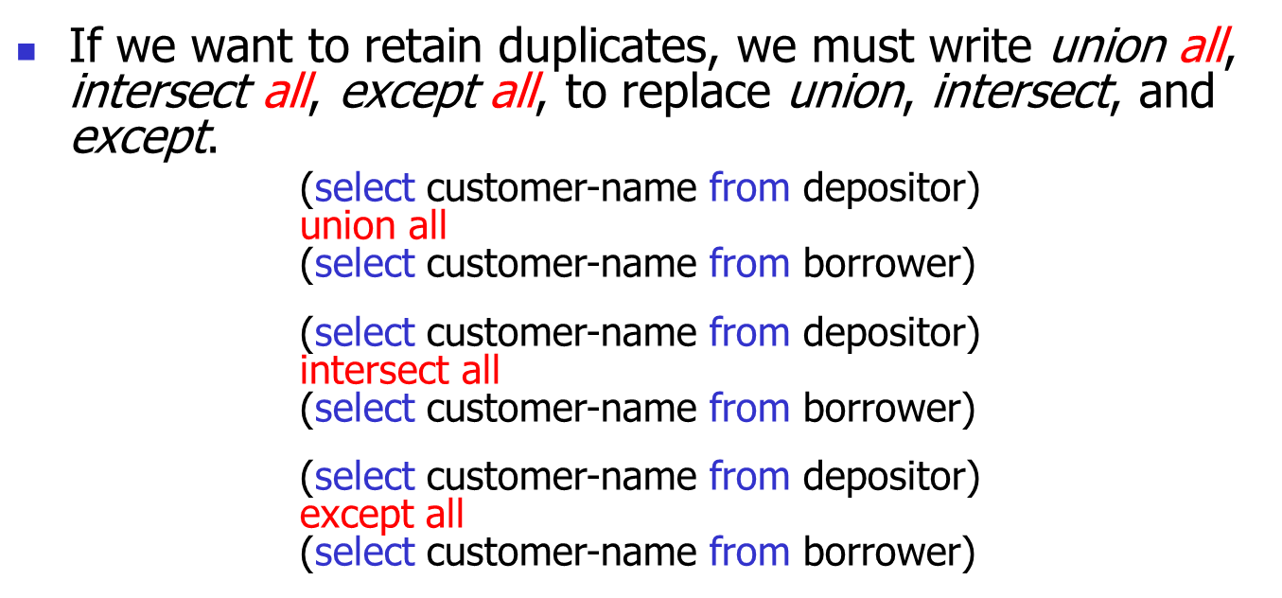
Set operations
  Borrower (customer-name, loan-number)
  Depositor (customer-name, account-number)

Slide 65
Set operations
In Oracle, minus is used instead of except

Slide 66
Exercise
Q1: Find all the course IDs taught either in Fall 2009 or in Spring 2010, or both.
Q2: Find all the course IDs taught in Fall 2009 and in Spring 2010.
Q3: Find all the course IDs taught in Fall 2009 but not in Spring 2010.
  section (course_id, sec_id, semester, year, building, room_number, time_slot_id)

Slide 67
Exercise
Q1: Find all the course IDs taught either in Fall 2009 or in Spring 2010, or both.
(select course_id
from section
where semester=‘Fall’ and year=2009)
union
(select course_id
from section
where semester=‘Spring’ and year=2010)
  section (course_id, sec_id, semester, year, building, room_number, time_slot_id)

Slide 68
Exercise
Q2: Find all the course IDs taught in Fall 2009 and in Spring 2010.
(select course_id
from section
where semester=‘Fall’ and year=2009)
intersect
(select course_id
from section
where semester=‘Spring’ and year=2010)
  section (course_id, sec_id, semester, year, building, room_number, time_slot_id)

Slide 69
Exercise
Q3: Find all the course IDs taught in Fall 2009, but not in Spring 2010.
(select course_id
from section
where semester=‘Fall’ and year=2009)
except
(select course_id
from section
where semester=‘Spring’ and year=2010)
  section (course_id, sec_id, semester, year, building, room_number, time_slot_id)

Slide 70
Data Manipulation Language (DML)
Basic SQL Query
Arithmetic Operation
Rename Operation
String Operation
Ordering the Display of Tuples
Aggregate Operation
Set Operation
Natural Join
Nested subqueries
Division
Group By
NULL value
Sequence

Slide 71
SQL – Natural join
Natural join operation operates on two relations and produces a relation as the result.
Unlike the Cartesian product of two relations, which combines each tuple of the first relation with every tuple of the second, natural join considers only those two pairs of tuples with the same value on those attributes that appear in both relations.

Slide 72
Natural Join Example
Can_fly Plane
R1 R2 = σ_{R1.model_no = R2.model_no}(R1 × R2)
Emp_No
Model_No
Maker
Model_No
Emp_No
Model_No
Maker
1001
B727
Airbus
A310
1003
A310
Airbus
1001
B747
Airbus
A320
1002
A320
Airbus
1001
DC10
Airbus
A330
1002
A340
Airbus
1002
A320
Airbus
A340
=
1001
B727
Boeing
1002
A340
Boeing
B727
1001
B747
Boeing
1002
B757
Boeing
B747
1002
B757
Boeing
1002
DC9
Boeing
B757
1001
DC10
MD
1003
A310
MD
DC10
1002
DC9
MD
1003
DC9
MD
DC9
1003
DC9
MD

Slide 73
SQL – Natural join
For all instructors in the university, who have taught some courses, find their names and the cause ID of all courses they taught.
select name, course_id
from instructor, teaches
where instructor.ID=teaches.ID
select name, course_id
from instructor natural join teaches
  instructor (ID, name, dept_name, salary)
  teaches (ID, course_id, sec_id, semester, year)

Slide 74
Data Manipulation Language (DML)
Basic SQL Query
Arithmetic Operation
Rename Operation
String Operation
Ordering the Display of Tuples
Aggregate Operation
Set Operation
Natural Join
Nested subqueries
Division
Group By
NULL value
Sequence

Slide 75
SQL - Nested Subqueries
SQL supports the subqueries.
A subquery is a select-from-where expression that is nested within another query.
You can replace a value or set of values with a SQL statement (ie., a subquery)
select * select *
from loan from loan
where amount > 1200 where amount > select avg(amount)
from loan
Illegal if the subquery returns the wrong type for the comparison

Slide 76
SQL - Nested Subqueries
Every SQL statement returns
  a relation/set in the result, or
  Null, or
  A single atomic value
The subqueries could be used to perform tests for set membership, make set comparisons and determine set cardinality.
The nested subquery can be used in the where clause, or in the from clause.

Slide 77
Set membership-in, not in
SQL allows testing tuples for membership in a relation.
The in connective tests for set membership, where the set is a connection of values produced by a selected clause.
Similarly, the not in connective tests for the absence of set membership.

Slide 78
Set membership- in, not in
Find all customers who have both a loan and an account in the bank.
select distinct customer-name
from borrower
where customer-name in (select customer-name
from depositor)
(select customer-name from borrower)
intersect
(select customer-name from depositor)
For each borrower,
check if he/she is also a depositor
Return the set of depositors
  Borrower (customer-name, loan-number)
  Depositor (customer-name, account-number)

Slide 79
Set membership- in, not in
Find all customers who have a loan at the bank but do not have an account at the bank.
select distinct customer-name
from borrower
where customer-name not in (select customer-name
from depositor)
(select customer-name from borrower)
except
(select customer-name from depositor)
For each borrower,
check if he/she is also a depositor
Return the set of depositors
  Borrower (customer-name, loan-number)
  Depositor (customer-name, account-number)

Slide 80
Set membership- in, not in
The in and not in operators can also be used on a given set.
Example: find all customers whose names are neither “John” nor “Mike”
select distinct customer-name
from borrower
where customer-name not in (‘John’, ‘Mike’)
  Borrower (customer-name, loan-number)
  Depositor (customer-name, account-number)

Slide 81
Set membership- in, not in
It is also possible to test for membership in a multiple-attribute relation.
select count(distinct ID)
from takes
where (course_id, sec_id) in (select course_id, sec_id
from teaches
where teaches.ID=10101)

Slide 82
Set comparison- some
Find all branches that have greater assets than at least one branch located in Brooklyn
SQL allows to compare sets using nested subquery.
select distinct T.branch-name
from branch as T, branch as S
where T.assets > S.assets and S.branch-city=“Brooklyn”

Slide 83
Nested Subqueries- some
Find all branches that have greater assets than at least one branch located in Brooklyn
  select branch-name
  from branch
  where assets > some
  (select assets
  from branch
  where branch-city = “Brooklyn”)
  The phrase “greater than at least one” is represented by >some
Assets of all branches in Brooklyn

Slide 84
Nested Subqueries- some
SQL allows <some, <=some, >some, >=some, =some, and <>some comparisons.
The above comparison returns true or false.
  NOTE: “=some” is the same as “in”.
  Is “<>some” the same as “not in”?
not the same

Slide 85
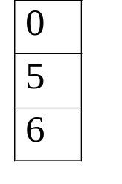
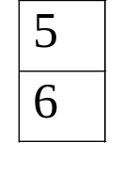
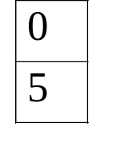
Nested Subqueries- some
(5 > some ) returns
(5 > some ) returns
(5 = some ) returns
(5 ≠ some ) returns
true (5 > 0)
false
true
true (since 0 ≠ 5)

Slide 86
Nested Subqueries- all
Find the names of all branches that have greater assets than all branches located in Brooklyn.
select branch-name
from branch
where assets > all
(select assets
from branch
where branch-city=“Brooklyn”)
Assets of all branches in Brooklyn

Slide 87
Nested Subqueries- all
SQL allows <all, <=all, >all, >=all, =all, and <>all comparisons.
The above comparison returns true or false.
  Note: “<>all” is identical to “not in”?
  Is “=all” the same as “in”?
not the same

Slide 88
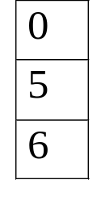
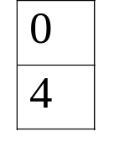
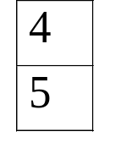
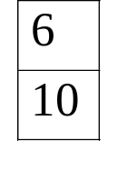
All Semantics
(5 > all ) returns
(5 > all ) returns
(5 = all ) returns
(5 ≠ all ) returns
false
true
false
true

Slide 89
Test for Empty Relations
SQL includes a feature for testing whether a subquery has any tuples in its result.
Word exists returns true if the argument subquery is nonempty.
exists( )
true
exists( )
false

Slide 90
Test for Empty Relations
Find all customer names who have both a loan and an account.
select customer-name
from depositor as D
where exists
(select *
from borrower as B
where D.customer-name = B.customer-name)
For each depositor d,
- find a set S of borrowers
with the same name as d
- if exists(S) (i.e., there exists
at least one element in S),
return d
  Borrower (customer-name, loan-number)
  Depositor (customer-name, account-number)

Slide 91
Test for Empty Relations
Find all customer names who have an account but no loan.
select customer-name
from depositor as D
where not exists
(select *
from borrower as B
where D.customer-name = B.customer-name)
For each depositor d,
- find a set S of borrowers
with the same name as d
- if not exists(S) (i.e., there
does not exist at least one
element in S),
return d

Slide 92
Test for the absence of duplicates tuples
SQL includes a boolean function for testing whether a subquery has duplicate tuples in its result.
The unique returns the value true if the argument subquery contains no duplicate tuples.
The not unique returns the value true if the argument subquery contains duplicate tuples.

Slide 93
Test for the absence of duplicates tuples
Find all courses that were offered at most once in 2009.
select T.course_id
from course as T
where unique (select R. course_id
from section as R
where T.course_id=R.course_id and R.year=2009)

Slide 94
Test for the absence of duplicates tuples
Find all courses that were offered at least twice in 2009.
select T.course_id
from course as T
where not unique (select R. course_id
from section as R
where T.course_id=R.course_id and R.year=2009)

Slide 95
Subqueries in the from clause
SQL allows a subquery expression to be used in the from clause.
Any select-from-where expression returns a relation as a result, which can be inserted into another select-from-where as a relation

Slide 96
Subqueries in the from clause
Find the average instructors’ salaries of those departments where the average is greater than 42,000$.
select dept_name, avg_salary
from (select dept_name, avg(salary) as avg_salary
from instructor
group by dept_name)
where avg_salary>420000;
  instructor (ID, name, dept_name, salary)

Slide 97
The with clause
The with clause provides a way of defining a temporary relation whose definition is available only to the query in which the with clause occurs.
  E.g., find the departments with the maximum budget
with max_budget (value) as
(select max(budget)
from department)
select dept_name
from department, max_budget
where department.budget=max_budget.value
  department (dept_name, building, budget)

Slide 98
Data Manipulation Language (DML)
Basic SQL Query
Arithmetic Operation
Rename Operation
String Operation
Ordering the Display of Tuples
Aggregate Operation
Set Operation
Natural Join
Nested subqueries
Division
Group By
NULL value
Sequence

Slide 99
Division
Let A have two attributes x and y
Let B have one attribute y
A/B contains all x tuples, such that for every y tuple in B there is a xy tuple in A
A
x | y
s1 | p1
s1 | p2
s1 | p3
s1 | p4
s2 | p1
s2 | p2
s3 | p2
s4 | p2
s4 | p4
B
/
y
x
p2
=
s1
A/B
p4
s4

Slide 100
Division in SQL
Find all customers with an account at all branches located in Brooklyn.
select distinct S.customer-name
from depositor as S
where not exist (
(select branch-name
from branch
where branch-city=“Brooklyn”)
except
(select R.branch-name
from account as R, depositer as T
where S.customer-name = T.customer-name and
T.account-number = R.account-number) )
For each
customer S,
check ...
Branches in Brooklyn
All branches where
customer S
has an account
  Account (account-number, balance, branch-name)
  Depositor (customer-name, account-number)

Slide 101
Division in SQL
Find all student IDs (sids) of the students who took all courses in table Course
Take / Course
select distinct S.sid
from Take as S
where not exist (
)
Take
sid | cid
1 | 231
1 | 170
1 | 111
1 | 001
2 | 231
2 | 001
3 | 170
4 | 231
4 | 170
(select cid
from Course
Course
except
/
cid
sid
(select R.cid
from Take as R
where S. sid=R.sid)
231
=
1
170
4

Slide 102
Data Manipulation Language (DML)
Basic SQL Query
Arithmetic Operation
Rename Operation
String Operation
Ordering the Display of Tuples
Aggregate Operator
Set Operation
Division
Group By
NULL value
Sequence

Slide 103
Group by
SQL can apply the aggregate function not only to a single set of tuples, but also to a group of sets of tuples.
The group by clause can be used to form groups according to the values of attributes.
Tuples with the same value on all attributes in the group by clause are placed in one group.
group by attributes

Slide 104
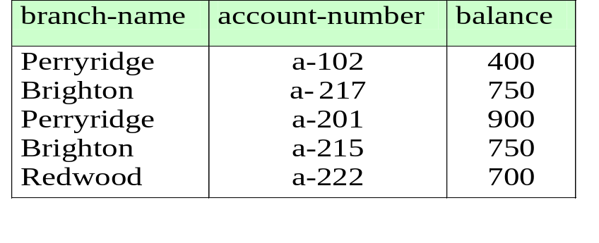
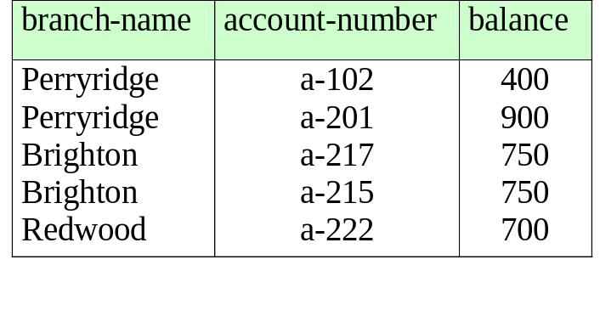
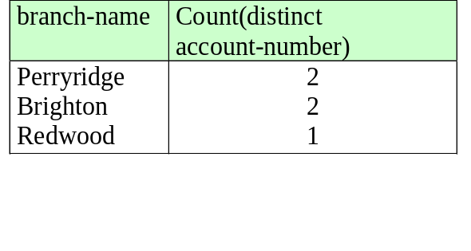
Group by
Find the number of accounts for each branch.
For each group of tuples with the same branch-name, apply
aggregate function count and distinct to account-number
select branch-name, count(distinct account-number)
from account
group by branch-name
account table

Slide 105
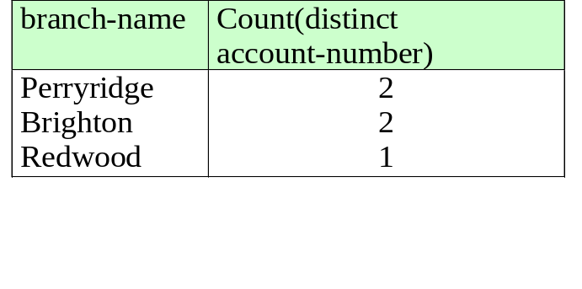
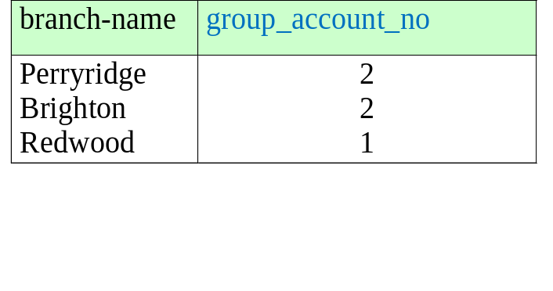
Group by
Find the number of accounts for each branch.
select branch-name, count(account-number) as group_account_no
from account
group by branch-name

Slide 106
Group by Attributes
When an SQL query uses group by, we must ensure that the attributes that appear in the selected statement without being aggregated are those that are present in the group by clause.
In other words, any attribute that is not present in the group by clause must appear only inside an aggregate function if it appears in the select clause.
select branch-name, count(account-number) as group_account_no
from account
group by branch-name
select branch-name, balance, count(distinct account-number)
from account
group by branch-name

Slide 107
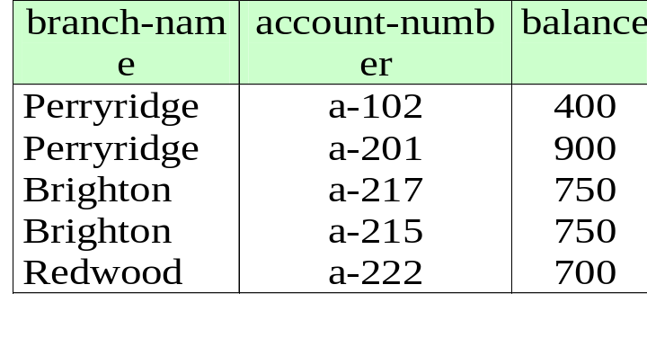
Group by Attributes
Attributes in select clause outside of aggregate functions must appear in group by list, why?
select branch-name, balance, count( distinct account-number)
from account
group by branch-name
select branch-name, balance, count( distinct account-number)
from account
group by branch-name, balance
OR
select branch-name, sum(balance), count(…) from account
group by branch-name

Slide 108
Group by with Join
Find the number of depositors for each branch.
Perform Join then group by then count ( distinct () )
Join ⇒ (customer-name, account-number, branch-name, balance)
Group by and aggregate functions apply to the Join result
select branch-name, count( distinct customer-name)
from depositor, account
where depositor.account-number = account.account-number
group by branch-name
depositor (customer-name, account-number)
account (branch-name, account-number, balance)

Slide 109
Group by Evaluation
branch-name
cust-name
Perryridge
John Wong
select branch-name, customer-name
from depositor, account
where depositor.account-number
= account.account-number
Perryridge
Jacky Chan
count
Uptown
John Wong
Uptown
Mary Kwan
Downtown
John Wong
branch-name
count
Downtown
Pat Lee
Perryridge
2
Downtown
May Cheung
Uptown
2
distinct
Downtown
3
branch-name
cust-name
branch-name
cust-name
Perryridge
John Wong
Perryridge
John Wong
Downtown
Pat Lee
Perryridge
Jacky Chan
Uptown
John Wong
group by
Perryridge
John Wong
Perryridge
Jacky Chan
Uptown
John Wong
Uptown
Mary Kwan
Uptown
Mary Kwan
Downtown
John Wong
Downtown
John Wong
Perryridge
John Wong
Downtown
Pat Lee
Downtown
May Cheung
Downtown
May Cheung

Slide 110
Having Clause
It is also useful to state a condition that applies to groups rather than to tuples.
Find the name of each branch where the average account balance is more than $700
select branch-name, avg(balance)
from account
group by branch-name
having avg (balance) >700
SQL applies predicates in the having clause after groups have been formed

Slide 111
Data Manipulation Language (DML)
Basic SQL Query
Arithmetic Operation
Rename Operation
String Operation
Ordering the Display of Tuples
Aggregate Operation
Set Operation
Natural Join
Nested subqueries
Division
Group By
NULL value
Sequence

Slide 112
NULL Value
field value unknown
  A new employee has not been assigned a supervisor yet.
field attribute non-exist
Employee
eno
ename
supervisor_eno
spouse_name
eno | ename | supervisor_eno | spouse_name
123 | Raymond | NULL | NULL
200 | Peter | 200 | Mary
300 | Mary | 123 | Peter

Slide 113
Comparison involving null values
eno | ename | supervisor_eno | spouse_name
123 | Raymond | NULL | NULL
200 | Peter | 300 | Mary
300 | Mary | 123 | Peter
unknown
false
true
select *
from employee
where supervisor_eno = 123
The condition following ‘where’ clause eliminates FALSE or unknown
eno | ename | supervisor_eno | spouse_name
300 | Mary | 123 | Peter

Slide 114
Comparison involving null values
eno | ename | supervisor_eno | spouse_name
123 | Raymond | NULL | Alice
200 | Peter | 300 | Mary
300 | Mary | 123 | Peter
unknown
true
select *
from employee
where supervisor_eno = 123 and
spouse_name = “Alice”
What is the answer?

Slide 115
Traditional logic
p | not p
p | q | p and q
true
false
true
true
true
false
true
true
false
false
false
true
false
false
false
false
p | q | p or q
true
true
true
true
false
true
false
true
true
false
false
false

Slide 116
Logic with unknown values
p | not p
p | q | p and q
unknown
unknown
true
unknown
unknown
unknown
true
unknown
false
unknown
false
unknown
false
false
p | q | p or q
true
unknown
true
unknown
true
true
false
unknown
unknown
unknown
false
unknown

Slide 117
NULL Value
eno | ename | supervisor_eno | spouse_name
123 | Raymond | NULL | Alice
200 | Peter | 300 | Mary
300 | Mary | 123 | Peter
unknown
true
unknown
false
false
false
true
false
false
select *
from employee
where supervisor_eno = 123 and
spouse_name = “Alice”
The answer contains no tuples

Slide 118
NULL Value
eno | ename | supervisor_eno | spouse_name
123 | Raymond | NULL | Alice
200 | Peter | 300 | Mary
300 | Mary | 123 | Peter
unknown
true
true
false
false
false
true
false
true
select *
from employee
where supervisor_eno = 123 or
spouse_name = “Alice”
eno | ename | supervisor_eno | spouse_name
123 | Raymond | NULL | Alice
300 | Mary | 123 | Peter

Slide 119
Data Manipulation Language (DML)
Basic SQL Query
Arithmetic Operation
Rename Operation
String Operation
Ordering the Display of Tuples
Aggregate Operation
Set Operation
Natural Join
Nested subqueries
Division
Group By
NULL value
Sequence

Slide 120
Sequence
Sequence is a set of integers 1, 2, … that are generated and supported by some database systems to produce unique values on demand.
The sequence of numeric values is generated in an ascending or descending order at defined intervals and can be configured to restart when exceeds max_value.

Slide 121
Sequence
Sequence created:
ascending order
descending order
CREATE sequence seq1
start with 1
increment by 3
minvalue 0
maxvalue 100
cycle;
CREATE sequence seq2
start with 100
increment by -1
minvalue 1
maxvalue 100
cycle;
SELECT seq1.NEXTVAL FROM dual;
  NEXTVAL
  ----------
  1

Slide 122
Sequence
SELECT seq1.NEXTVAL FROM dual;
  NEXTVAL
  ----------
  4
SELECT seq1.NEXTVAL FROM dual;
  NEXTVAL
  ----------
  7

Slide 123
Sequence
Example
CREATE sequence seq1
start with 1
increment by 1
minvalue 0
maxvalue 1000
cycle;
create table students
(
ID int,
name char(20));
INSERT into students VALUES(seq1.nextval,’John’);
INSERT into students VALUES(seq1.nextval,’Mike');
____________________
| ID | NAME |
--------------------
| 1 | John |
| 2 | Mike |
--------------------

Slide 124
Outline
Introduction
Data Definition Language (DDL)
  Fundamental concepts
Data Manipulation Language (DML)
Data Definition Language (DDL)
  Advanced concepts

Slide 125
Data Definition Language (DML)
Domain constraint
Referential integrity
Modification of the database
Views

Slide 126
Domain Constraints
Domain constraints are the most elementary form of integrity constraint.
They test values inserted in the database, and test queries to ensure that the comparisons make sense.
New domains can be created from existing data types
  create domain Dollars numeric(12, 2)
  create domain Pounds numeric(12,2)

Slide 127
Domain Constraints
The check clause permits domains to be restricted:
create domain hourly-wage numeric(5,2)
constraint wage-value-test check (value > 4.00)
new domain name
name of constraint
condition must be TRUE
Constraint name (optional): if the constraint is violated, the constraint name
is returned and can be used to identify the error
The domain hourly-wage is a decimal number with 5 digits,
2 of which are placed after the decimal point.
The domain has a constraint that ensures that the hourly wage is greater than 4.00.

Slide 128
Domain Constraints
Example: create a table “bank_account” with “account_type” field having value either “checking” or “saving”:
create domain Account_type varchar(20)
constraint acc_type_test check(value in ("Checking", "Saving"));
create table bank_account
(
…
account_type Account_type)

Slide 129
Data Definition Language (DML)
Domain constraint
Referential integrity
Modification of the database
Views

Slide 130
Referential Integrity in SQL
In relationship, data is linked between two or more tables. This is achieved by having the Foreign key reference a primary key in a parent table. Because of this, we need to ensure the data on both sides of the relationship remain intact.
Referential integrity refers to the accuracy and consistency of data within a relationship. It requires that whenever a foreign key value is used, it must reference a valid, existing primary key in the parent table.

Slide 131
Referential Integrity in SQL
Primary, candidate keys and foreign keys can be specified as part of the SQL create table statement:
  The primary key clause lists attributes that comprise the primary key.
  The unique key clause lists attributes that comprise a candidate key.
  The foreign key clause lists the attributes that comprise the foreign key and the name of the relation referenced by the foreign key.
By default, a foreign key references the primary key attributes of the referenced table
  foreign key (account-number) references account

Slide 132
Primary and Candidate Keys in SQL
Possibly many candidate keys (specified using UNIQUE), one of which is chosen as the primary key.
CREATE TABLE Enrolled
(sid CHAR(20)
cid CHAR(20),
grade CHAR(2),
PRIMARY KEY (sid,cid))
CREATE TABLE Enrolled
(sid CHAR(20)
cid CHAR(20),
grade CHAR(2),
PRIMARY KEY (sid),
UNIQUE (cid, grade))

Slide 133
Foreign Key
Account
account-number
branch-name
balance
Create table account
( account-number char(10) not null,
branch-name char(15),
balance integer,
primary key (account-number)
foreign key (branch-name) references branch )
Branch
branch-name
branch-district
assets

Slide 134
Create table depositor
( customer-name char(20) not null,
account-number char(10) not null,
primary key (customer-name, account-number),
foreign key (customer-name) references customer
foreign key (account-number) references account )
Depositor
customer-name
account-number

Slide 135


Can we simply add ( KLN, 111, 3 ) to Account?
No.
Can we simply add ( Chris, 222 ) to Depositor?
No.
Can we simply add ( Mary, 999 ) to Depositor?
No.
e.g.
What can we add to Depositor?
Customer
Branch
Account
Depositor

Slide 136
Can we simply delete Customer Tim from table Customer?
No.
Can we simply delete branch HKUST from table Branch?
No.
e.g.
How can we remove Customer Tim from table Customer?
Customer
Branch
Account
Depositor

Slide 137
Cascading Actions in SQL
create table account
( . . .
foreign key(branch-name) references branch
on delete cascade)
With on delete cascade clause, if a delete of a tuple in branch results in referential-integrity constraint violation, the delete “cascades” to the account relation, deleting the tuple that refers to the branch that was deleted.

Slide 138
Cascading Actions in SQL
Cascading delete:
Delete Customer Tim, cascaded delete on depositor
create table depositor
(customer-name char(15),
account-number char(10) not null,
primary key (customer-name, account-number),
foreign key (customer-name) references customer
on delete cascade,
foreign key (account-number) references account
on delete cascade)

Slide 139
After we specify “on delete cascade” in table Depositor in “create table statement”,
If we remove tuple Tim from table customer,
all tuples for Tim in table Depositor will be removed automatically.
e.g.
Customer
Branch
Account
Depositor

Slide 140
Cascading Actions in SQL
If there is a chain of foreign-key dependencies across multiple relations, with on delete cascade specified for each dependency, a deletion or update at one end of the chain can propagate across the entire chain.
Cascading delete:
Delete branch HKUST, cascaded delete on account, depositor

Slide 141
Cascading Actions in SQL
create table account
( . . .
foreign key(branch-name) references branch
on delete cascade
on update cascade)
Cascading updates are similar.

Slide 142
Data Definition Language (DML)
Domain constraint
Referential integrity
Modification of the database
Views

Slide 143
Record Deletion
A delete request is expressed in much the same way as a query.
delete from r
where P;
We can delete only whole tuples; we cannot delete values on any particular attributes.

Slide 144
Record Deletion
Delete all account records at the Perryridge branch
delete from account
where branch-name = “Perryridge”
Conceptually, delete is done in two steps:
  find the tuples you want to delete:
  select *
  from account
  where branch-name = “Perryridge”
  delete the tuples you found.

Slide 145
Record Deletion
Example: Delete the record of all accounts with balances below the average at the bank.
delete from account
where balance < (select avg (balance)
from account)
  Solution used in SQL:
  1. First, compute avg balance and find all tuples to delete
  2. Next, delete all tuples found above

Slide 146
Record Insertion
To insert data into a relation, we either specify a tuple to be inserted or write a query whose result is a set of tuples to be inserted.
  The tuples inserted must have the correct number of attributes.
  The attributed values to be inserted must satisfy the domain constraint.

Slide 147
Record Insertion
Add a new tuple to account
insert into account values (“A-9732”, 1200, “Perryridge”)
To reorder attributes, specify attribute names explicitly:
insert into account (branch-name, balance, account-number) values (“Perryridge”, 1200, “A-9732”)
Add a new tuple to account with balance set to null
insert into account values (“A-777”, null, “Perryridge”)
  Account (account-number, balance, branch-name)

Slide 148
  Loan (loan-number, amount, branch-name)
  Account (account-number, branch-name, balance)
  Borrower (customer-name, loan-number)
  Depositor (customer-name, account-number)
Insert tuples on the basis of the result of a query.
Example: Provide as a gift for all loan customers of the Perryridge branch, a $200 savings account. Let the loan number serve as the account number for the new savings account
insert into account
select loan-number, branch-name, 200
from loan
where branch-name = ‘Perryridge’
insert into depositor
select customer-name, loan-number
from loan, borrower
where branch-name = ‘Perryridge’
and loan.loan-number = borrower.loan-number

Slide 149
Record Updates
We may wish to change a value without changing all values in the tuple.
The update statement can be used.

Slide 150
Record Updates
Increase the balance of the account with account-number = “A-123” to 2000
update account
set balance = 2000
where account-number = “A-123”
  Account (account-number, branch-name, balance)

Slide 151
Record Updates
All instructors with salary over $100,000 receives a 3 percent raise, whereas all others receive a 5 percent raise.
Note: the order of the two update statements is important. If we change the order, an instructor with a salary just under 100,000 would receive an over 8 percent raise.
update instructor
set salary = salary*1.03
where salary> 100,000
update instructor
set salary = salary*1.05
where salary<= 100,000

Slide 152
Record Updates
SQL provides a case construct that we can use to perform both the updates with a single update statement.
update instructor
set salary = case
when salary<=100,000 then salary*1.05
else salary*1.03
end

Slide 153
Record Updates
The general form of the case statement is as follows:
The operation returns result_{i}, if the condition pred_{i} is satisfied; otherwise, it returns result₀.
case
when pred₁ then result₁
when pred₂ then result₂
…
when pred_{n} then result_{n}
else result₀
end

Slide 154
Data Definition Language (DML)
Domain constraint
Referential integrity
Modification of the database
Views

Slide 155
Views
It is not desirable for all users to see the entire logical model.
Provide views to hide certain data from the view of certain users.

Slide 156
Views
To create a view, we use the create view command:
create view view-name as <query expression>
<query expression> can be any legal SQL query.

Slide 157
Views
EXAMPLE: Create a view from loan(branch-name, loan-number, amount) that hides the amount information.
create view branch-loan as
select branch-name, loan-number
from loan
Then, a user who has access to the view, but not the loan table, cannot see the amount.
loan(branch-name, loan-number, amount)

Slide 158
Views
QUERY: Once we defined a view, we can use the view name to refer to the virtual relation that the view generates.
Example: find all loans in the Perryridge branch (from view branch-loan)
select loan-number
from branch-loan
where branch-name = “Perryridge”

Slide 159
Views
We can remove the veiws
Drop view branch-loan

Slide 160
Two Components in SQL
Assertion
  checking
Trigger
  checking and manipulation

Slide 161
Assertion
An assertion is a complex constraint that the database must always satisfy
An assertion in SQL takes the form
create assertion <assertion-name> check <predicate>

Slide 162
  Loan (loan-number, amount, branch-name)
  Account (account-number, branch-name, balance) Branch (branch-name, branch-city, assets)
Example: Ensuring the sum of loan amounts for each branch is less than the sum of all account balances at the branch.
create assertion sum-constraint check
(not exists
(select *
from branch
where(select sum(amount)
from loan
where loan.bname=branch.bname)>=
(select sum(balance)
from account
where account.bname = branch.bname)))

Slide 163
  Loan (loan-number, amount, branch-name)
  Account (account-number, branch-name, balance)
  Borrower (customer-name, loan-number)
  Depositor (customer-name, account-number)
Example: Ensuring every loan customer keeps a minimum of $1000 in an account.
create assertion balance-constraint check
(not exists
(select *
from loan as L
where not exists
empty
(select *
from borrower as B, depositor as D, account as A
where L.loan-number = B.loan-number
and B.cname = D.cname
and D.account-number = A.account-number
and A.balance >= 1000)))
not empty

Slide 164
Assertion
When an assertion is made, the system tests it for validity.
If the assertion is valid, any further modification to the database is allowed only if it does not cause that assertion to be violated.

Slide 165
Trigger
A trigger is a statement that is executed automatically by the system as a side effect of a modification to the database
A trigger in SQL takes the form
  Specify the conditions under which the trigger is executed.
  Specify the actions to be taken by the trigger.
create trigger <trigger-name> …

Slide 166
Trigger Example
Trigger is a complex concept.
Example: suppose that instead of allowing negative account balances, the bank deals with overdrafts by
  setting the account balance to zero
  creating a loan in the amount of the overdraft
  giving this loan a loan number which is identical to the account number of the overdrawn account.
The condition for executing the trigger is an update to the account relation that results in a negative balance value.

Slide 167
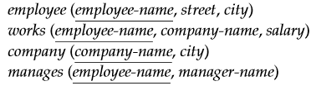
Exercise
Consider the employee database, where the primary keys are underlined.
Q1. Find the names and cities of residence of all employees who work for First Bank Corporation.
Q2. Find the names, street addresses, and cities of residence of all employees who work for First Bank Corporation and earn more than $10,000.
Q3. Find all employees in the database who live in the same cities as the companies for which they work.
Q4. Assume that the companies may be located in several cities. Find all companies located in every city in which Small Bank Corporation is located.
Q5. Find the company that has the most employees.

Slide 168
Exercise
Q1: Find the names and cities of residence of all employees who work for First Bank Corporation.
select e.employee-name, city
from employee as e, works as w
where w.company-name= ‘First BankCorporation’
and w.employee-name= e.employee-name

Slide 169
Exercise
Q2: Find the names, street addresses, and cities of residence of all employees who work for First Bank Corporation and earn more than $10,000.
select *
from employee
where employee-name in (select employee-name
from works
where company-name= ‘First Bank Corporation’
and salary>10000)

Slide 170
Exercise
Q3: Find all employees in the database who live in the same cities as the companies for which they work.
select e.employee-name
from employee as e, works as w, company as c
where e.employee-name= w.employee-name
and e.city = c.city and w.company-name= c.company-name

Slide 171
Exercise
Q4. Assume that the companies may be located in several cities. Find all companies located in every city in which Small Bank Corporation is located.
select S.company-name
from company as S
where not exists((select city
from company
where company-name= ’SmallBank Corporation’)
except
(select city
from company T
where S.company-name= T.company-name))

Slide 172
Exercise
Q5. Find the company that has the most employees
select company-name
from works
group by company-name
Having count (distinct employee-name) >=all
(select count (distinct employee-name)
from works
group by company-name)

Slide 173
Thank you!

